Slide 1

Hospital Management System
Java Individual Project Presentation
Presented by: Darahasini.D(2520030289)
Cluster:1 , Section:4
Supervisor Name: Madhuri Mam
Department of CSE

Slide 2
Outline
Abstract
Existing System
Proposed System
System Architecture
Project Modules
Objectives
Co’s Attainments - FWD
Co1
Co2 …….. 5. Co5
Co’s Attainments - DSA
Co1
Co2 …….. 5. Co5
Screen Shots for FWD & DSA
Conclusion
Geo-Tagged Photos

Slide 3
Abstract
The Hospital Management System is a web-based platform designed to simplify the management of hospital services and patient information. The main objective of this project is to create a centralized system where patients can view doctors, book appointments, and access basic hospital services online, while administrators can manage doctor details and appointments efficiently.
The website includes features such as doctor listings, appointment scheduling, and a dashboard interface to organize hospital activities. It is developed using HTML, CSS, and JavaScript to provide a simple, responsive, and interactive user interface. This system helps improve hospital management, reduce manual work, and provide easier access to healthcare services for patients.

Slide 4
Existing System
In the existing system, most hospitals manage patient records, appointments, and doctor information manually or through basic communication methods such as phone calls and paper records. Although these methods allow hospitals to provide services, they are not well organized and it becomes difficult to manage patient information efficiently.
Appointment scheduling is often done manually, which can lead to delays, confusion, and longer waiting times for patients. In addition, patient records and doctor details may not be easily accessible when needed. Because of these limitations, managing hospital operations becomes time-consuming and less efficient. Therefore, a dedicated digital platform is needed to organize hospital services and manage patient and doctor information effectively.

Slide 5
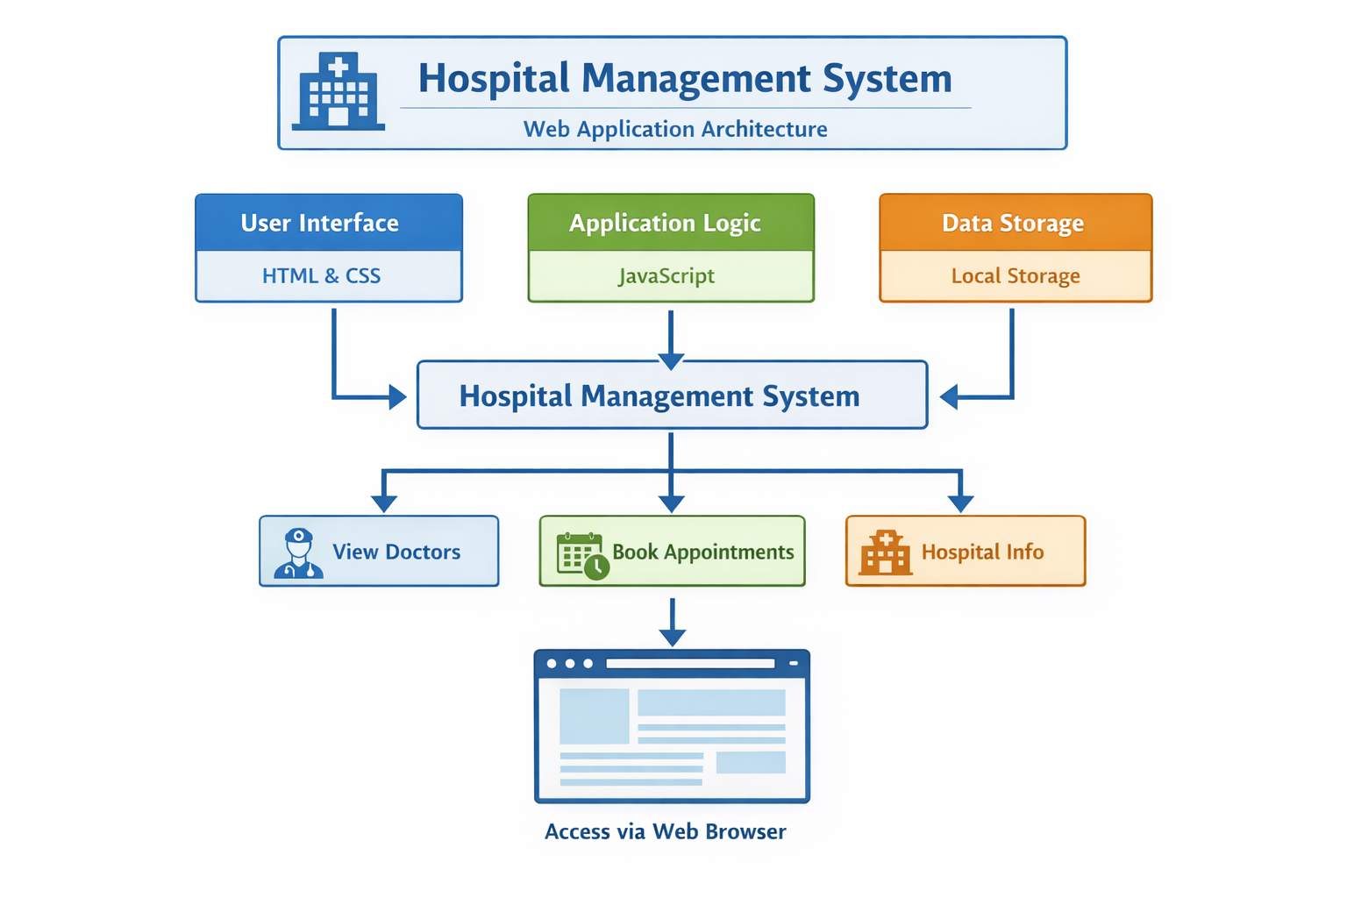
System Architecture

Slide 6
Project Modules
User Registration & Login:
Allows users to create accounts and log in to the system.
Doctor Management:
Displays the list of doctors and their specializations.
Appointment Booking:
Enables patients to book appointments with doctors.
Patient Information:
Stores basic patient and appointment details.
Dashboard:
Shows hospital services, doctors, and appointments in one place.

Slide 7
Objectives
To create a platform where patients can easily view doctors and hospital services.
To provide a centralized system for managing hospital information.
To allow patients to book appointments with doctors online.
To help hospitals organize patient and doctor details efficiently.
To provide a simple and user-friendly interface for users.

Slide 8
Co’s Attainments - FWD
CO1 – Apply Internet Fundamentals, HTML & Introductory CSS Styling
The project uses HTML to design the structure of the hospital website (forms, doctor cards, dashboard) and CSS for styling and layout, showing basic web development concepts.
CO2 – Apply HTML Forms, Semantic Tags & Comprehensive CSS Layouts
The system includes login, signup, and appointment booking forms, uses semantic HTML elements, and implements responsive layouts using CSS.
CO3 – Apply JavaScript Programming Essentials
JavaScript is used to handle user input, manage doctor and appointment data, and store information using localStorage.
CO4 – Apply JavaScript Interactivity & DOM
The project uses DOM manipulation and event handling to dynamically display doctors, appointments, and user interactions.
CO5 – Apply Advanced Web Development & Deployment
The project integrates features like appointment booking, doctor listings, dashboard interface, and interactive UI, demonstrating advanced front-end web development.

Slide 9
Co’s Attainments - DSA
CO1: Implemented searching and sorting algorithms to manage doctor and appointment data efficiently.
CO2: Used Linked List to store and manage patient or appointment records.
CO3: Applied Stack and Queue to manage recent activities and appointment requests.
CO4: Used HashMap (hashing) for quick access to patient or doctor details using IDs.
CO5: Developed a practical application using linear data structures for hospital data management.
CO6: Built a menu-driven Java program integrating multiple data structures and algorithms.

Slide 10
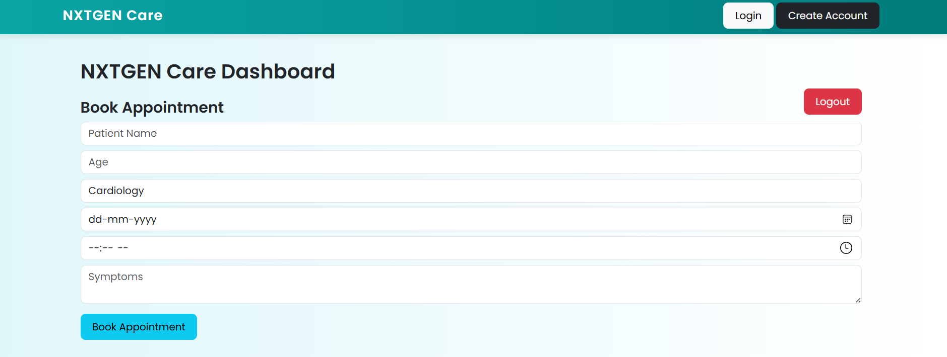
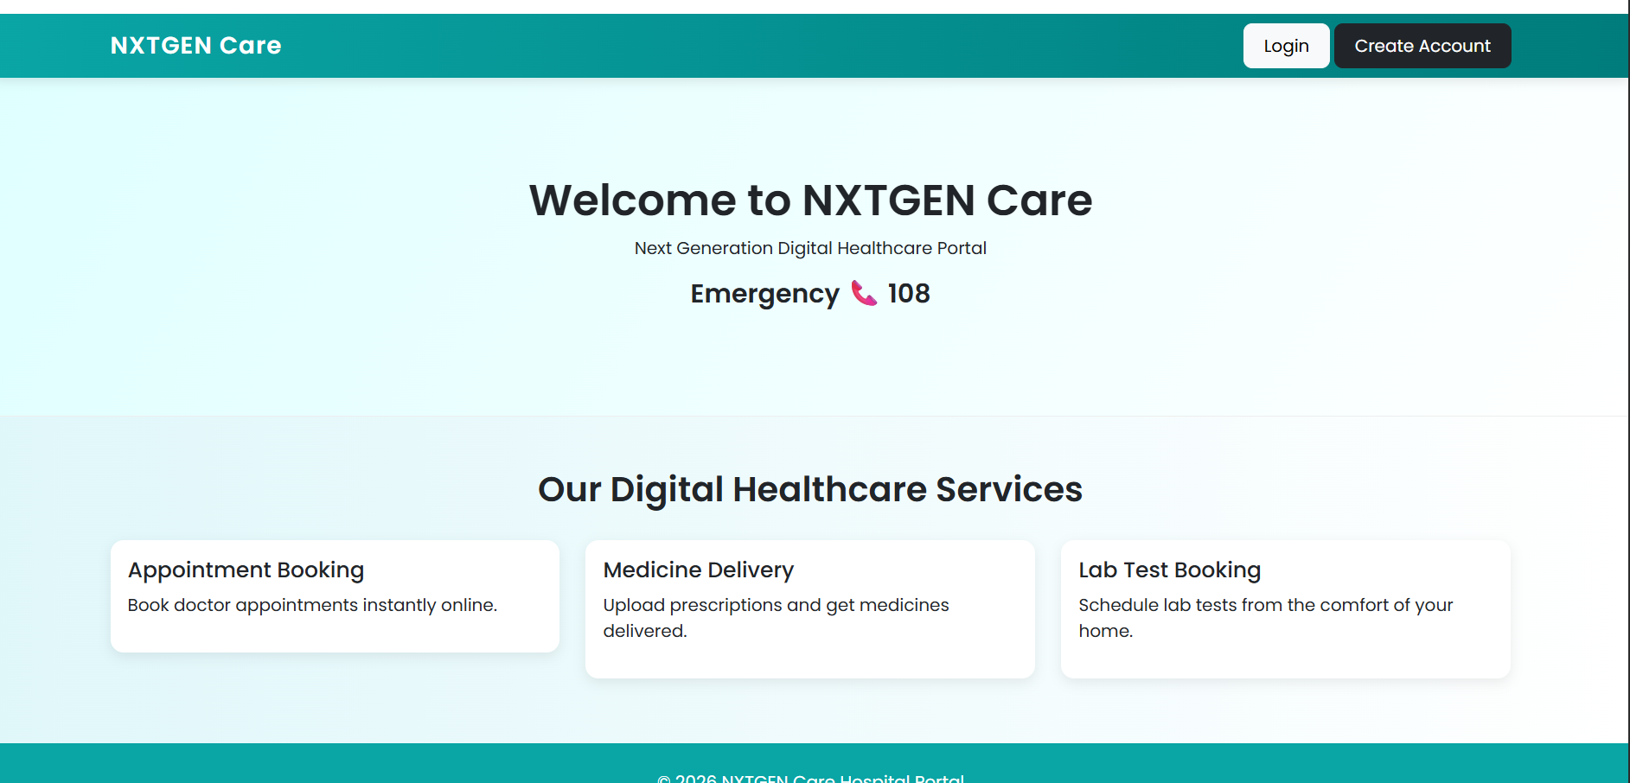
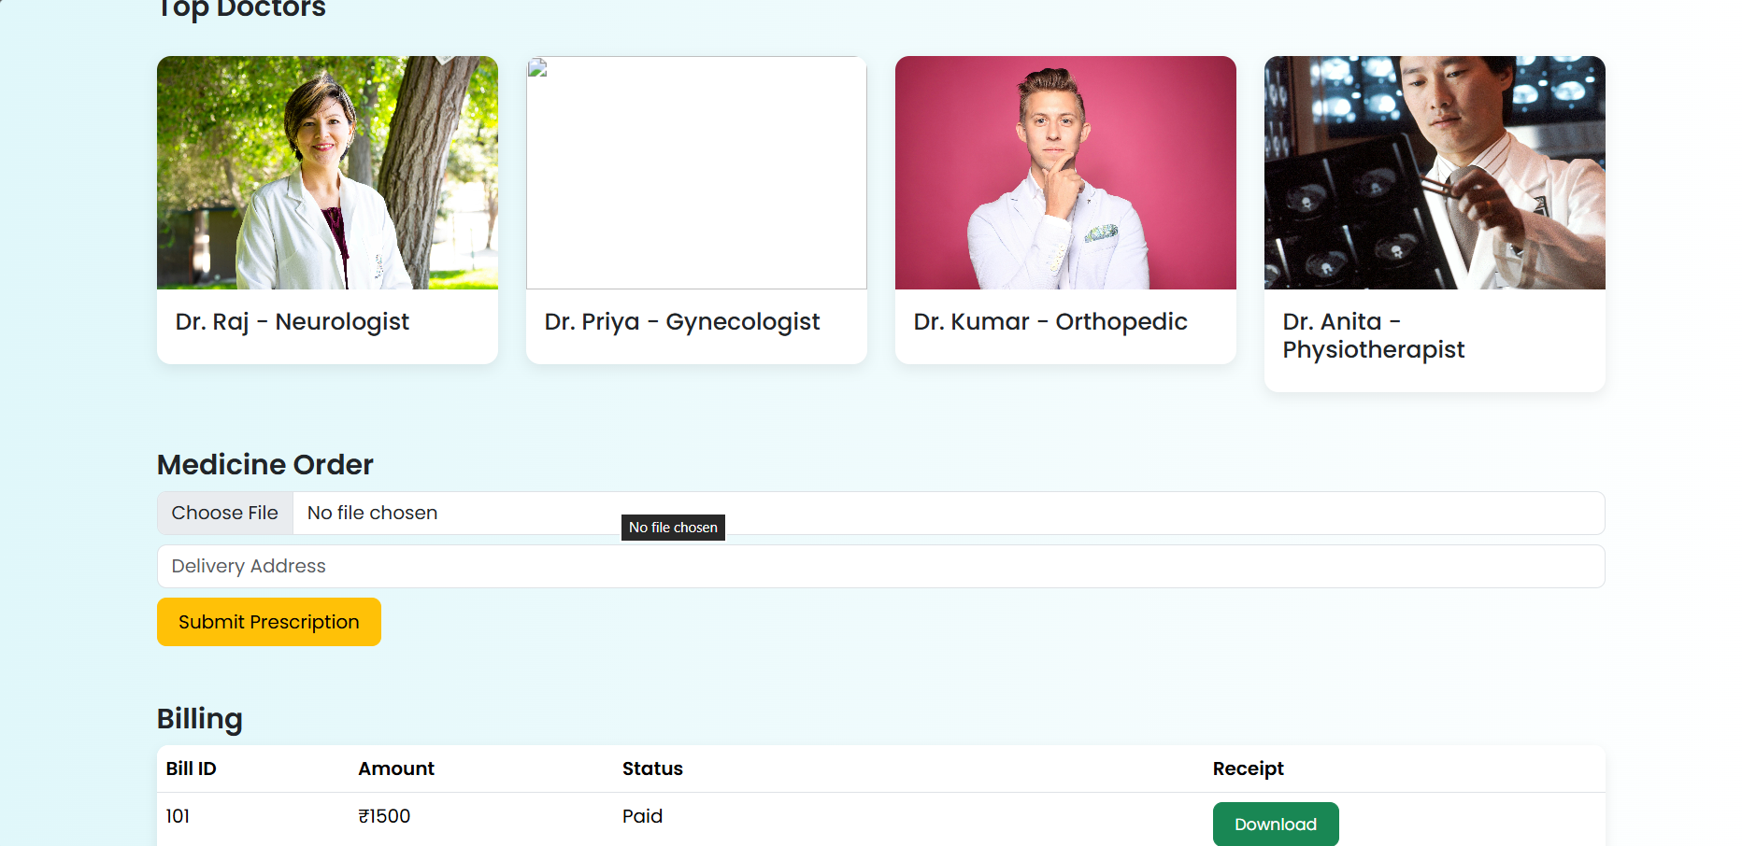
Screenshots for fwd

Slide 11
Conclusion
The Hospital Management System demonstrates the practical implementation of a web-based application using HTML, CSS, and JavaScript. The system allows users to view doctors, book appointments, and access hospital information through a simple and interactive interface. It helps organize patient and doctor details efficiently and reduces manual work in managing hospital services. Overall, the project shows how basic web technologies can be used to develop a simple and effective hospital management system that improves accessibility and management of healthcare services.

Slide 12
Geo Tag Photos

Slide 13
THANK YOU

